Slide 1
Sales Forecasting Across Multiple Retail Stores
Submitted by:-
Himanshu sharma

Slide 2
Introduction
This project focuses on building a sales forecasting solution for Rossmann Pharmaceuticals, a company with retail stores across several cities. The objective is to forecast sales for each store six weeks in advance, aiding the finance team in strategic planning and resource allocation.
Currently, store managers rely on experience and judgment to predict sales. However, factors such as promotions, holidays, competition, seasonality, and location significantly influence sales trends.

Slide 3
Exploratory Data Analysis (EDA):
Understand customer purchasing behavior.
Analyze the effect of holidays, promotions, and assortment types on sales.
Visualize and summarize insights using plots and tables.
Machine Learning Modeling:
Preprocess data, engineer new features, and handle missing values.
Build regression models (e.g., Random Forest) using scikit-learn pipelines.
Evaluate models with a chosen loss function and analyze feature importance.

Slide 4
Deep Learning Modeling:
Build an LSTM (Long Short-Term Memory) model using TensorFlow or PyTorch.
Convert the sales data into a time series format.
Focus on sales trends and stationarity, and perform autocorrelation analysis.
Model Deployment:
Serve predictions via a Flask or Streamlit web app.
Allow inputs such as store ID and CSV upload of features (date, promo status, etc.).
Visualize and download prediction results.

Slide 5
MLOps Integration :-
Use MLFlow for model tracking and versioning.
Apply logging and DVC for version control of data and models.

Slide 6
Libraries Used
Data Analysis & Visualization
pandas – for data manipulation and cleaning
matplotlib – for plotting graphs and charts
seaborn – for statistical data visualization
Machine Learning
scikit-learn – for building ML models (e.g., Random Forest), pipelines, evaluation metrics
Data Preprocessing
numpy – for numerical operations
datetime – for working with dates
sklearn.preprocessing – for scaling and encoding features (e.g., LabelEncoder, StandardScaler)

Slide 7
Deep Learning:-
TensorFlow (specifically Keras) – for building LSTM-based models for time series forecasting (Note: PyTorch could be used alternatively, but TensorFlow is specified in the document.)
Deployment:-
Flask or Streamlit – for creating a web-based interface to serve predictions
joblib or pickle – for saving and loading trained models
MLOps:-
mlflow – for model tracking, versioning, and experimentation

Slide 8
Problem facing
Missing or Wrong Data Some data was missing or not filled properly (like store open/close info, promotion status, etc.).
Dates Were Tricky Converting dates into useful features (like weekday, month, etc.) was confusing.
Too Many Features Deciding which features to keep or remove was difficult and affected model accuracy.
Model Was Slow or Overfitting Some models took a long time to train, or worked well on training data but not on test data.
LSTM Was Hard to Use Preparing data for LSTM (like changing shape and scaling) was challenging.
Making the Web App Work Connecting the model to a web app using Flask or Streamlit caused issues like file upload errors or wrong predictions.
Using MLFlow Was New Tracking models and experiments using MLFlow was difficult at first for beginners.

Slide 9
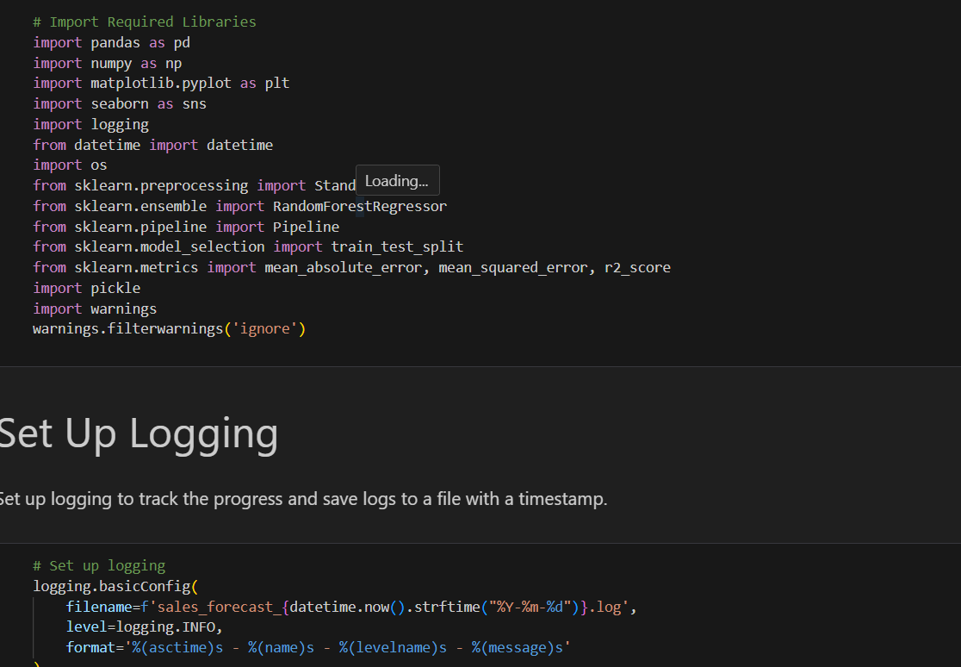
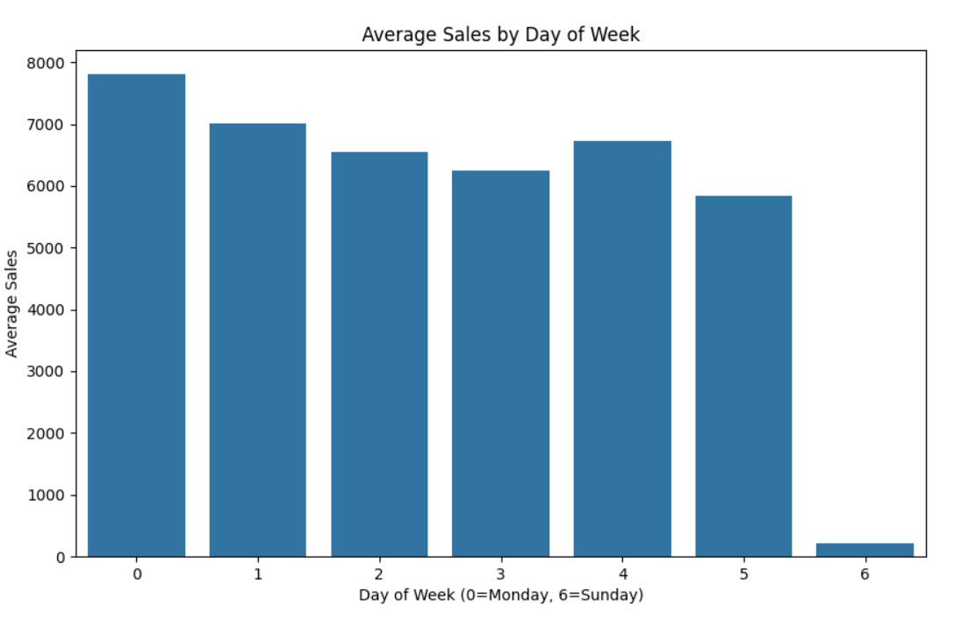

Slide 10
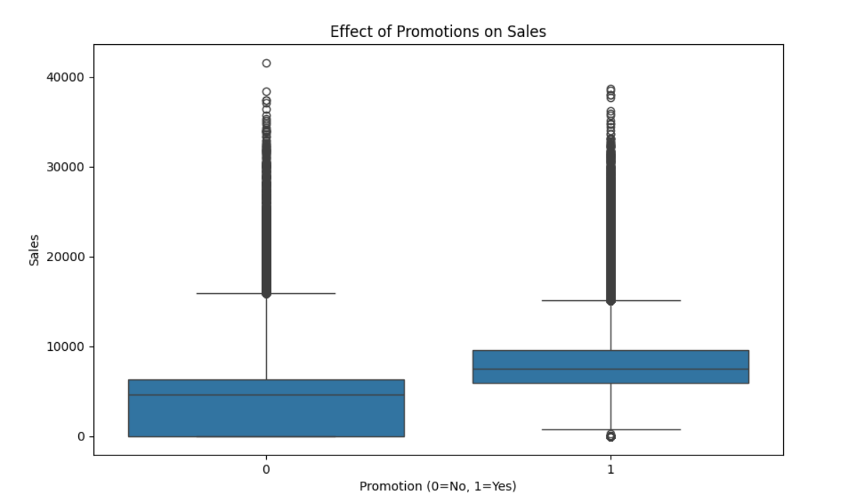
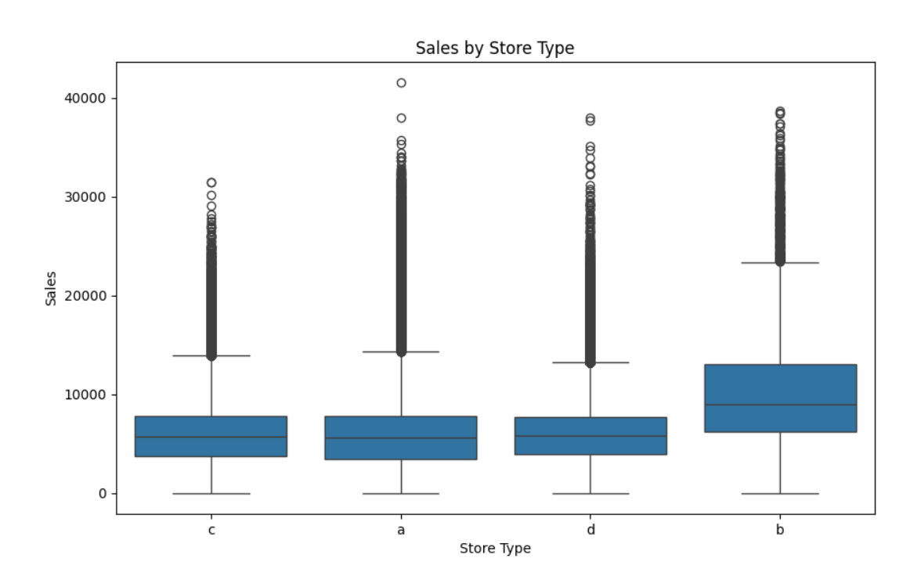

Slide 11
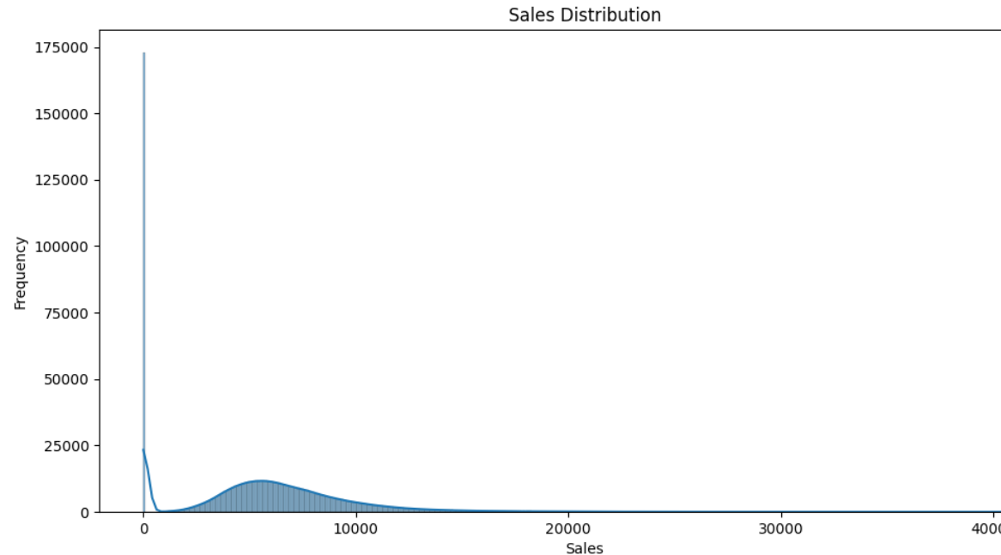
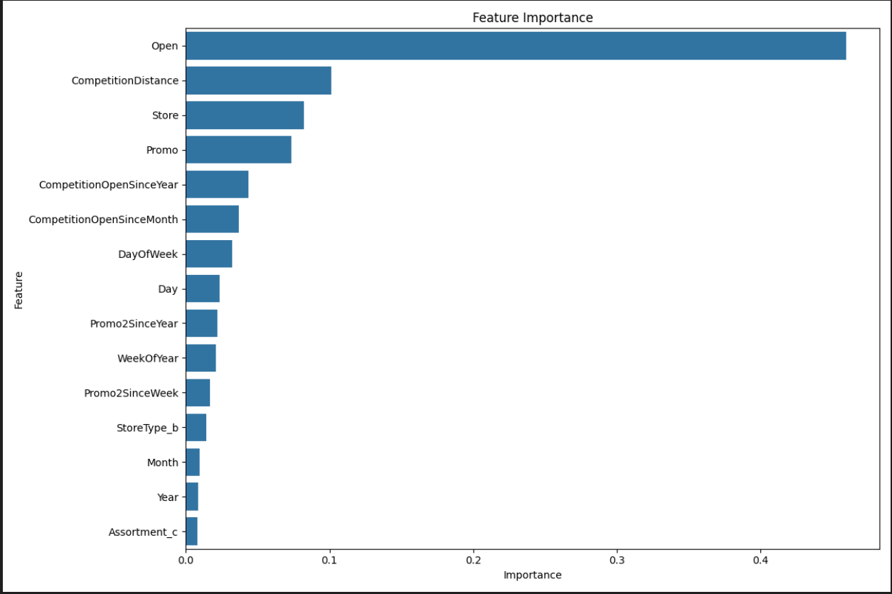

Slide 12
Conclusion
Data Understanding & Insights:
Conducted detailed exploratory data analysis (EDA) to uncover key factors affecting sales such as promotions, holidays, store type, and competition.
Extracted time-based and business-specific features to enrich the dataset.
Model Development:
Built robust machine learning models using Random Forest and Scikit-learn pipelines for baseline predictions.
Developed a deep learning LSTM model to capture temporal patterns in sales, improving accuracy for time-dependent forecasts.

Slide 13
Performance Evaluation:
Models were evaluated using appropriate regression metrics (e.g., RMSE), and important features were identified to explain sales variation.
Time-based splitting ensured realistic validation and testing.
Production Deployment:
Successfully deployed the best-performing model using a Flask or Streamlit web app, allowing users to upload input data and receive sales predictions interactively.
Enabled CSV file input, result visualization, and download features in the web app.

Slide 14
MLOps Integration:
Used MLflow for tracking experiments and model versions, ensuring reproducibility.
Introduced version control with Git and DVC for better project management and collaboration.
Learning Outcomes:
Gained hands-on experience in the end-to-end data science workflow: from data preprocessing to web deployment.
Learned to balance both traditional ML and modern deep learning models in solving structured data problems.
Understood the importance of model interpretability, modular code, and experiment tracking in real-world applications.

Slide 15
Thank You

